Slide 1
CSS INCLUSION

Slide 2
CSS INCLUSION
There are four ways to associate styles with your HTML document.
Most commonly used methods are inline CSS and External CSS.

Slide 3
Embedded CSS -The <style> Element
You can put your CSS rules into an HTML document using the <style> element.
This tag is placed inside the <head>...</head> tags.
Rules defined using this syntax will be applied to all the elements available in the document.
Here is the generic syntax:

Slide 4
Embedded CSS -The <style> Element
<head>
<style type="text/css" media="...">
Style Rules
............
</style>
</head>

Slide 5
Embedded CSS -The <style> Element
Attributes associated with <style> elements are:
Attribute
type
Value
text/css
Description
Specifies the style sheet language as a content-type (MIME type).
This is a required attribute.

Slide 6
Embedded CSS -The <style> Element
Attribute
media
Value
screen
tty
tv
projection
handheld
print
braille
aural
all
Description
Specifies the device, the document will be displayed on.
Default value is all.
This is an optional attribute.

Slide 7
Embedded CSS -The <style> Element
Following is an example of embed CSS based on the above syntax:
<head>
<style type="text/css" media="all">
h1{
color: #36C;
}
</style>
</head>

Slide 8
Inline CSS –The style Attribute
You can use style attribute of any HTML element to define style rules.
These rules will be applied to that element only.
Here is the generic syntax:
<element style="...style rules....">

Slide 9
Inline CSS –The style Attribute
Attribute
style
Value
style rules
Description
The value of style attribute is a combination of style declarations separated by semicolon (;).

Slide 10

Inline CSS –The style Attribute
Following is the example of inline CSS based on the above syntax:
<h1 style ="color:#36C;"> This is inline CSS </h1>
It will produce the following result:

Slide 11
External CSS -The <link> Element
The <link> element can be used to include an external stylesheet file in your HTML document.
An external style sheet is a separate text file with .css extension.
You define all the Style rules within this text file and then you can include this file in any HTML document using <link> element.

Slide 12
External CSS -The <link> Element
Here is the generic syntax of including external CSS file:
<head>
<link type="text/css" href="..." media="..." />
</head>
Attributes associated with <style> elements are:

Slide 13
External CSS -The <link> Element
Attribute
type
Value
text/css
Description
Specifies the style sheet language as a content-type (MIME type).
This attribute is required.

Slide 14
External CSS -The <link> Element
Attribute
href
Value
URL
Description
Specifies the style sheet file having Style rules.
This attribute is a required.

Slide 15
External CSS -The <link> Element
Attribute
media
Value
screen
tty
tv
projection
handheld
print
braille
aural
all
Description
Specifies the device the document will be displayed on.
Default value is all.
This is an optional attribute.

Slide 16
External CSS -The <link> Element
Consider a simple style sheet file with a name mystyle.css having the following rules:
h1, h2, h3 {
color: #36C;
font-weight: normal;
letter-spacing: .4em;
margin-bottom: 1em;
text-transform: lowercase;
}

Slide 17
External CSS -The <link> Element
Now you can include this file mystyle.css in any HTML document as follows:
<head>
<link type="text/css" href="mystyle.css" media="all" />
</head>

Slide 18
Imported CSS -@import Rule
@import is used to import an external stylesheet in a manner similar to the <link> element.
Here is the generic syntax of @import rule.
<head>
@import "URL";
</head>

Slide 19
Imported CSS -@import Rule
Here URL is the URL of the style sheet file having style rules.
You can use another syntax as well:
<head>
<@import url("URL");
</head>

Slide 20
Imported CSS -@import Rule
Following is the example showing you how to import a style sheet file into an HTML document:
<head>
@import "mystyle.css";
</head>

Slide 21
CSS Rules Overriding
We have discussed four ways to include style sheet rules in an HTML document.
Here is the rule to override any Style Sheet Rule.
Any inline style sheet takes the highest priority.
So, it will override any rule defined in <style>...</style> tags or the rules defined in any external style sheet file.

Slide 22
CSS Rules Overriding
Any rule defined in <style>...</style> tags will override the rules defined in any external style sheet file.
Any rule defined in the external style sheet file takes the lowest priority, and the rules defined in this file will be applied only when the above two rules are not applicable.

Slide 23
Handling Old Browsers
There are still many old browsers who do not support CSS.
So, we should take care while writing our Embedded CSS in an HTML document.
The following snippet shows how to use comment tags to hide CSS from older browsers:

Slide 24
Handling Old Browsers
<style type="text/css">
<!--
body, td {
color: blue;
}
-->
</style>

Slide 25
CSS Comments
Many times, you may need to put additional comments in your style sheet blocks.
So, it is very easy to comment any part in the style sheet.
You can simply put your comments inside /*.....this is a comment in style sheet.....*/.
You can use /* ....*/ to comment multi-line blocks in similar way you do in C and C++ programming languages.

Slide 26
CSS Comments
/* This is an external style sheet file */
h1, h2, h3 {
color: #36C;
font-weight: normal;
letter-spacing: .4em;
margin-bottom: 1em;
text-transform: lowercase;
}
/* end of style rules. */

Slide 27
MEASUREMENT UNITS
Before we start the actual exercise, we would like to give a brief idea about the CSS Measurement Units.
CSS supports a number of measurements including absolute units such as inches, centimeters, points, and so on, as well as relative measures such as percentages and em units.

Slide 28
MEASUREMENT UNITS
You need these values while specifying various measurements in your Style rules e.g. border="1px solid red".
We have listed out all the CSS Measurement Units along with proper Examples:

Slide 29
MEASUREMENT UNITS
Unit
%
Description
Defines a measurement as a percentage relative to another value, typically an enclosing element.
Example
p {font-size: 16pt; line-height: 125%;}

Slide 30
MEASUREMENT UNITS
Unit
cm
Description
Defines a measurement in centimeters.
Example
div {margin-bottom: 2cm;}

Slide 31
MEASUREMENT UNITS
Unit
em
Description
A relative measurement for the height of a font in em spaces.
Because an em unit is equivalent to the size of a given font, if you assign a font to 12pt, each "em" unit would be 12pt; thus, 2em would be 24pt.
Example
p {letter-spacing: 7em;}

Slide 32
MEASUREMENT UNITS
Unit
ex
Description
This value defines a measurement relative to a font's x-height.
The x-height is determined by the height of the font's lowercase letter x.
Example
p {font-size: 24pt; line-height: 3ex;}

Slide 33
MEASUREMENT UNITS
Unit
in
Description
Defines a measurement in inches.
Example
p {word-spacing: .15in;}

Slide 34
MEASUREMENT UNITS
Unit
mm
Description
Defines a measurement in millimeters.
Example
p {word-spacing: 15mm;}

Slide 35
MEASUREMENT UNITS
Unit
pc
Description
Defines a measurement in picas.
A pica is equivalent to 12 points; thus, there are 6 picas per inch.
Example
p {font-size: 20pc;}

Slide 36
MEASUREMENT UNITS
Unit
pt
Description
Defines a measurement in points.
A point is defined as 1/72nd of an inch.
Example
body {font-size: 18pt;}

Slide 37
MEASUREMENT UNITS
Unit
px
Description
Defines a measurement in screen pixels.
Example
p {padding: 25px;}

Slide 38
COLORS
CSS uses color values to specify a color.
Typically, these are used to set a color either for the foreground of an element (i.e., its text) or for the background of the element.
They can also be used to affect the color of borders and other decorative effects.

Slide 39
COLORS
You can specify your color values in various formats.
Following table lists all the possible formats:

Slide 40
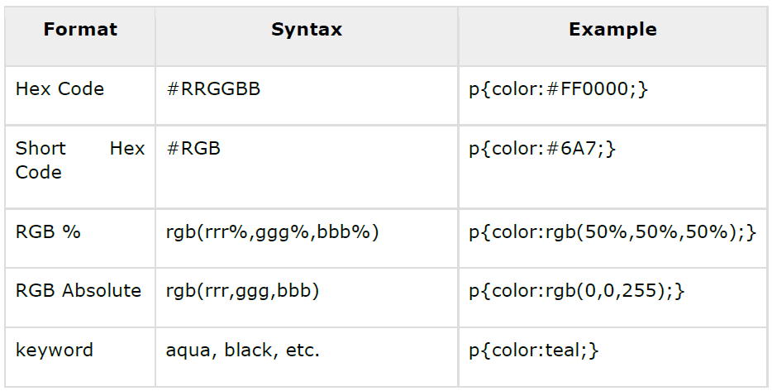
COLORS

Slide 41
CSS Colors -Hex Codes
A hexadecimal is a 6 digit representation of a color.
The first two digits (RR) represent a red value, the next two are a green value (GG), and the last are the blue value (BB).

Slide 42
CSS Colors -Hex Codes
A hexadecimal value can be taken from any graphics software like Adobe Photoshop, Jasc Paintshop Pro, or even using Advanced Paint Brush.
Each hexadecimal code will be preceded by a pound or hash sign ‘#’. Following are the examples to use Hexadecimal notation.

Slide 43
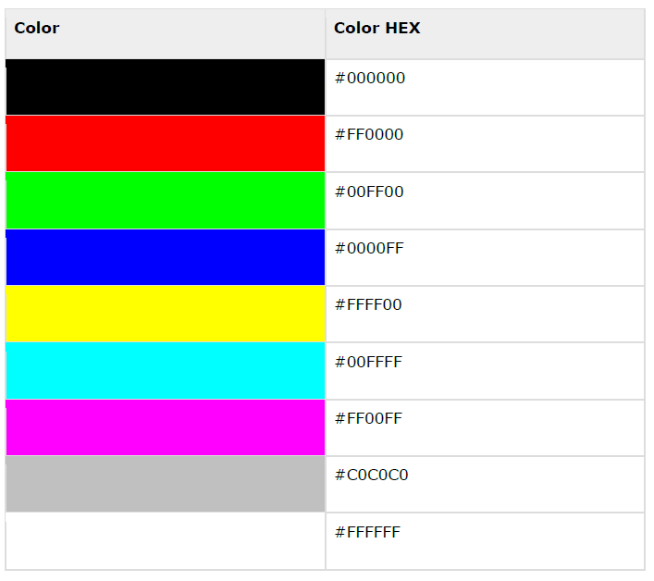

Slide 44
CSS Colors -Short Hex Codes
This is a shorter form of the six-digit notation.
In this format, each digit is replicated to arrive at an equivalent six-digit value.
For example: #6A7 becomes #66AA77.
A hexadecimal value can be taken from any graphics software like Adobe Photoshop, Jasc Paintshop Pro or even using Advanced Paint Brush.

Slide 45
CSS Colors -Short Hex Codes
Each hexadecimal code will be preceded by a pound or hash sign #.
Following are the examples to use the Hexadecimal notation.

Slide 46
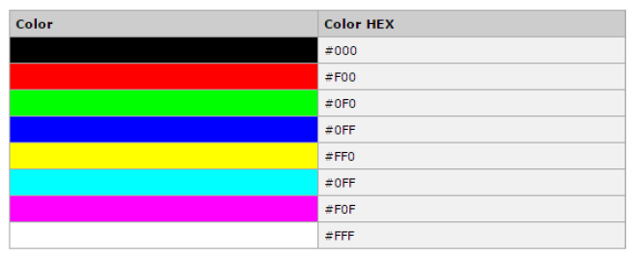
CSS Colors -Short Hex Codes

Slide 47
CSS Colors -RGB Values
This color value is specified using the rgb( ) property.
This property takes three values, one each for red, green, and blue.
The value can be an integer between 0 and 255 or a percentage.
NOTE: All the browsers does not support rgb() property of color, so it is recommended not to use it.
Following is the example to show few colors using RGB values.

Slide 48
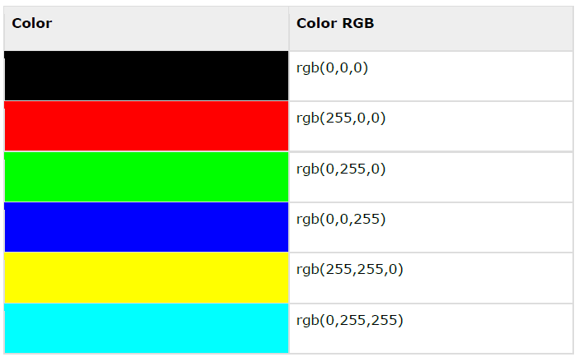


Slide 49
Browser Safe Colors
Here is the list of 216 colors, which are supposed to be most safe and computer independent colors.
These colors vary from hexa code 000000 to FFFFFF.
These colors are safe to use because they ensure that all computers would display the colors correctly when running a 256 color palette:

Slide 50
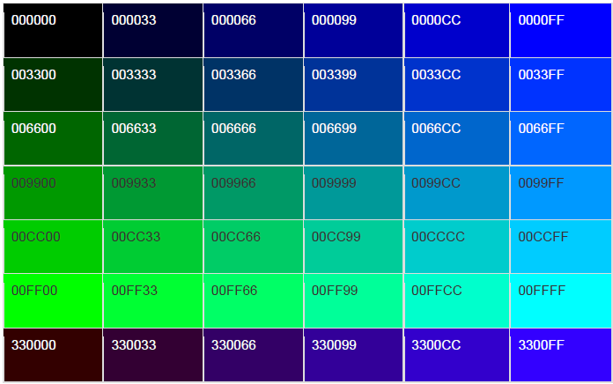
Browser Safe Colors

Slide 51
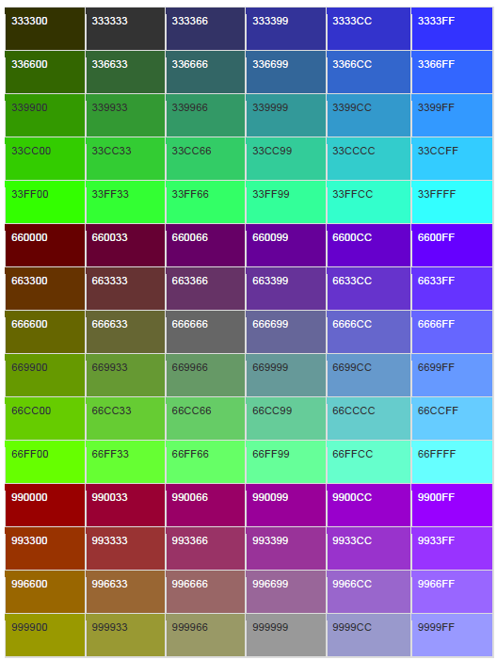

Slide 52
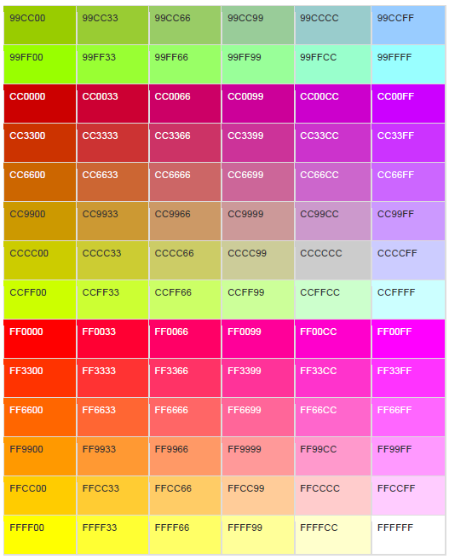

Slide 53
BACKGROUND
You can set the following background properties of an element:
The background-color property is used to set the background color of an element.
The background-image property is used to set the background image of an element.
The background-repeat property is used to control the repetition of an image in the background.

Slide 54
BACKGROUND
The background-position property is used to control the position of an image in the background.
The background-attachment property is used to control the scrolling of an image in the background.
The background property is used as a shorthand to specify a number of other background properties.

Slide 55
Set the Background Color
Following is the example, which demonstrates how to set the background color for an element.
<p style="background-color:yellow;">
This text has a yellow background color.
</p>
It will produce the following result:

Slide 56
Set the Background Image
<table style="background-image:url(/images/pattern1.gif);">
<tr><td>
This table has background image set.
</td></tr>
</table>

Slide 57
Repeat the Background Image
The following example demonstrates how to repeat the background image if an image is small.
You can use no-repeat value for the background-repeat property if you don't want to repeat an image.
In this case, the image will display only once.

Slide 58
Repeat the Background Image
By default, the background-repeat property will have a repeat value.
<table style="background-image:url(/images/pattern1.gif);
background-repeat: repeat;">
<tr><td>
This table has background image which repeats multiple times.
</td></tr>
</table>

Slide 59
Repeat the Background Image
The following example which demonstrates how to repeat the background image vertically.
<table style="background-image:url(/images/pattern1.gif);
background-repeat: repeat-y;">
<tr><td>
This table has background image set which will repeat vertically.
</td></tr>
</table>

Slide 60
Repeat the Background Image
The following example demonstrates how to repeat the background image horizontally.
<table style="background-image:url(/images/pattern1.gif);
background-repeat: repeat-x;">
<tr><td>
This table has background image set which will repeat horizontally.
</td></tr>
</table>

Slide 61
Set the Background Image Position
The following example demonstrates how to set the background image position 100 pixels away from the left side.
<table style="background-image:url(/images/pattern1.gif);
background-position:100px;">
<tr><td>
Background image positioned 100 pixels away from the left.
</td></tr>
</table>

Slide 62
Set the Background Image Position
The following example demonstrates how to set the background image position 100 pixels away from the left side and 200 pixels down from the top.
<table style="background-image:url(/images/pattern1.gif);
background-position:100px 200px;">
<tr><td>
This table has background image positioned 100
pixels away from the left and 200 pixels from the top.
</td></tr>
</table>

Slide 63
Set the Background Attachment
Background attachment determines whether a background image is fixed or scrolls with the rest of the page.
The following example demonstrates how to set the fixed background image.

Slide 64
Set the Background Attachment
<p style="background-image:url(/images/pattern1.gif);
background-attachment:fixed;">
This parapgraph has fixed background image.
</p>

Slide 65
Set the Background Attachment
The following example demonstrates how to set the scrolling background image.
<p style="background-image:url(/images/pattern1.gif);
background-attachment:scroll;">
This parapgraph has scrolling background image.
</p>

Slide 66
Shorthand Property
You can use the background property to set all the background properties at once.
For example:
<p style="background:url(/images/pattern1.gif) repeat fixed;">
This parapgraph has fixed repeated background image.
</p>

Slide 67
FONTS
You can set the following font properties of an element:
The font-family property is used to change the face of a font.
The font-style property is used to make a font italic or oblique.
The font-variant property is used to create a small-caps effect.

Slide 68
FONTS
The font-weight property is used to increase or decrease how bold or light a font appears.
The font-size property is used to increase or decrease the size of a font.
The font property is used as shorthand to specify a number of other font properties.

Slide 69
Set the Font Family
Following is the example, which demonstrates how to set the font family of an element.
Possible value could be any font family name.
<p style="font-family:georgia,garamond,serif;">
This text is rendered in either georgia, garamond, or the default
serif font depending on which font you have at your system.
</p>

Slide 70
Set the Font Family
It will produce the following result:
This text is rendered in either georgia, garamond, or the default serif font depending on which font you have at your system.

Slide 71
Set the Font Style
The following example demonstrates how to set the font style of an element.
Possible values are normal, italic and oblique.
<p style="font-style:italic;">
This text will be rendered in italic style
</p>

Slide 72
Set the Font Style
It will produce the following result:
This text will be rendered in italic style

Slide 73
Set the Font Variant
The following example demonstrates how to set the font variant of an element.
Possible values are normal and small-caps.
<p style="font-variant:small-caps;">
This text will be rendered as small caps
</p>

Slide 74
Set the Font Variant
It will produce the following result:
THIS TEXT WILL BE RENEDERED AS SMALL CAPS

Slide 75
Set the Font Weight
The following example demonstrates how to set the font weight of an element.
The font-weight property provides the functionality to specify how bold a font is.
Possible values could be normal, bold, bolder, lighter, 100, 200, 300, 400, 500, 600, 700, 800, 900.

Slide 76
Set the Font Weight
<p style="font-weight:bold;">
This font is bold.
</p>
<p style="font-weight:bolder;">
This font is bolder.
</p>
<p style="font-weight:900;">
This font is 900 weight.
</p>

Slide 77
Set the Font Weight
It will produce the following result:
This font is bold.
This font is bolder.
This font is 900 weight.

Slide 78
Set the Font Size
The following example demonstrates how to set the font size of an element.
The font-size property is used to control the size of fonts.
Possible values could be xx-small, x-small, small, medium, large, x-large, xx-large, smaller, larger, size in pixels or in %.

Slide 79
Set the Font Size
<p style="font-size:20px;">
This font size is 20 pixels
</p>
<p style="font-size:small;">
This font size is small
</p>
<p style="font-size:large;">
This font size is large
</p>

Slide 80
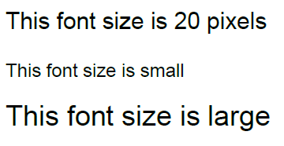
Set the Font Size
It will produce the following result:

Slide 81
Set the Font Size Adjust
The following example demonstrates how to set the font size adjust of an element.
This property enables you to adjust the x-height to make fonts more legible.
Possible value could be any number.

Slide 82

Set the Font Size Adjust
<p style="font-size-adjust:0.61;">
This text is using a font-size-adjust value.
</p>
It will produce the following result:

Slide 83
Set the Font Stretch
The following example demonstrates how to set the font stretch of an element.
This property relies on the user's computer to have an expanded or condensed version of the font being used.

Slide 84
Set the Font Stretch
Possible values could be normal, wider, narrower, ultra-condensed, extra-condensed, condensed, semi-condensed, semi-expanded, expanded, extra-expanded, ultra-expanded.

Slide 85
Set the Font Stretch
<p style="font-stretch:ultra-expanded;">
If this doesn't appear to work, it is likely that
your computer doesn't have a condensed or expanded
version of the font being used.
</p>

Slide 86
Set the Font Stretch
It will produce the following result:

Slide 87
Shorthand Property
You can use the font property to set all the font properties at once. For example:
<p style="font:italic small-caps bold 15px georgia;">
Applying all the properties on the text at once.
</p>
It will produce the following result:

